Slide 1
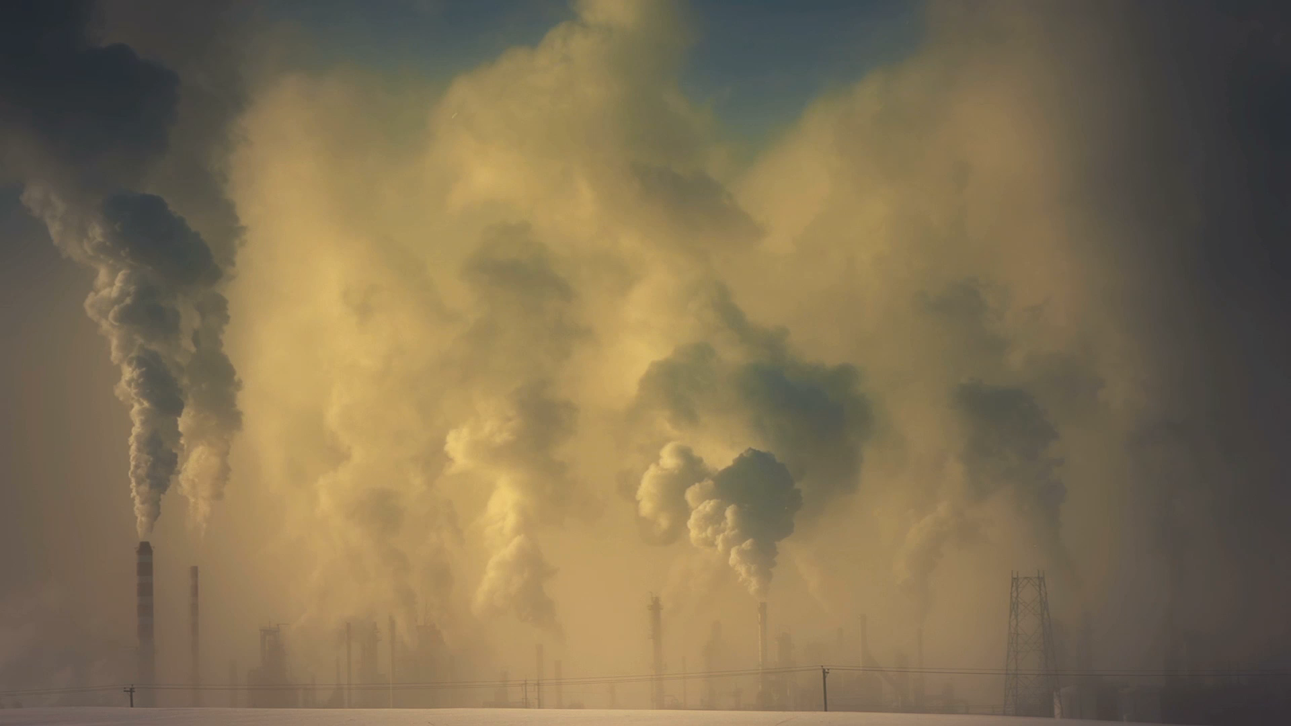
CO2 Emission Trends

Slide 2
Goals
Goals:
The Paris Accord states that the goal for CO2 emissions should be at least a 40% reduction by 2030 compared to 1990 CO2 levels (approx. 22 millions MtCO2). Goal is to analyze to see if this is achievable.
Statistical Analysis to find the countries that contributed the most to global CO2 emissions.

Slide 3
Structure
1) Data Exploration
2) Analysis
3) Data Visualization
4) Conclusion

Slide 4
Data Exploration
Kaggle Dataset provided by CICERO Center for International Climate Research
CO2 Emissions (MtCO2) from coal, oil, gas, cement, flaring, and other sources, as well as emissions per capita, are all included in this dataset. More than 60000 rows of data.

Slide 5
Data Cleaning
The dataset provided was cleaned and it was ready to be used for analysis. However, some cleaning was still done to properly used the data such as:
All rows except “global” were removed to analyze the global trend of CO2 and to come out with predictions.
All rows except 2021 year was shown to analyze the 2021 biggest polluters.
All rows except 2000 year was shown to analyze the 2020 biggest polluters.
All rows except 1980 year was shown to analyze the 1980 biggest polluters.

Slide 6
Analysis
Linear Regression
Unsupervised Machine Learning
Deep Neural Network

Slide 7
Linear Regression
Linear Regressions were made for 4 different timeframes
1750-2021
1900-2021
2000-2021
1980-2021

Slide 8
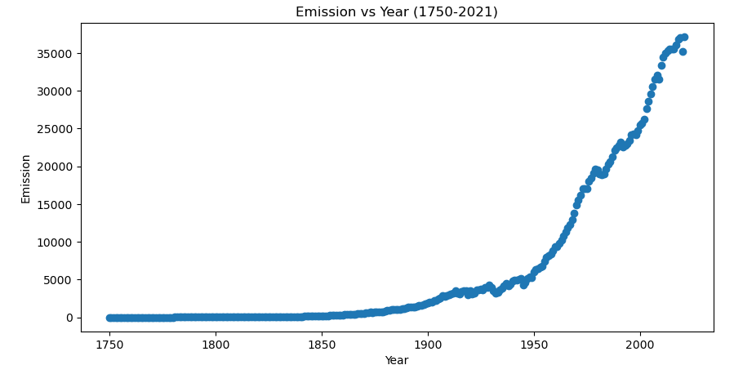
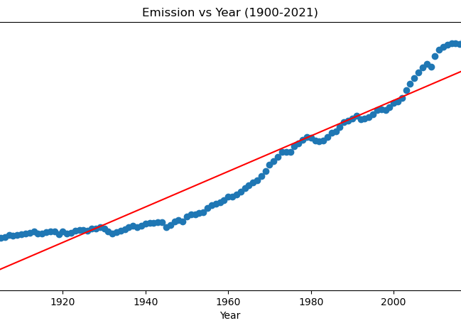
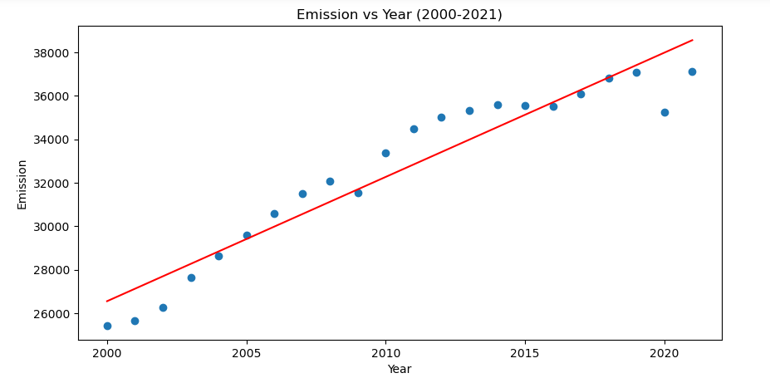
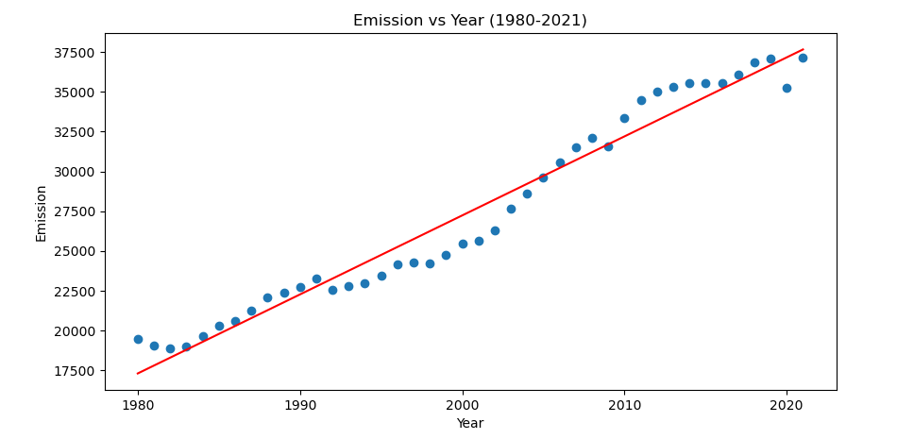
Timeframes Comparison
Exponential Regression Needed

Slide 9
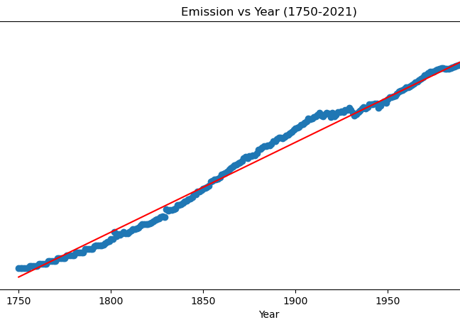
Timeframes Comparison
R2=0.987
R2=0.907
R2=0.914
R2=0.964

Slide 10
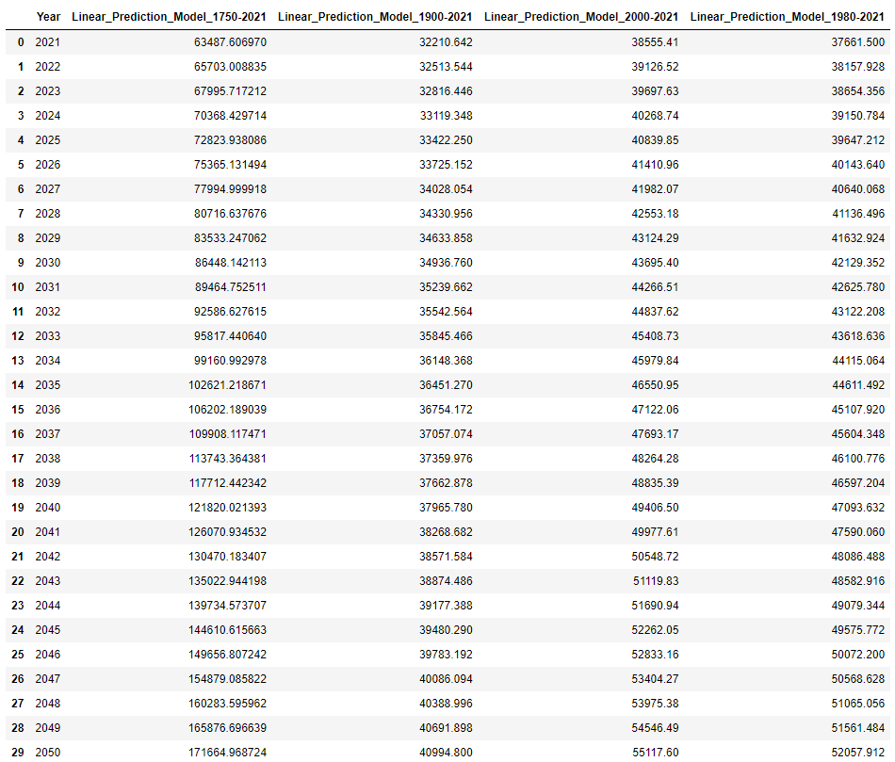










Prediction Model Results
Actual Emission in 2021 per our dataset : 37,123.85 million MtCO2
The 2000-2021 and 1980-2021 quite close in terms of predictions, signs of a constant growth rate for the last 40 years.

Slide 11
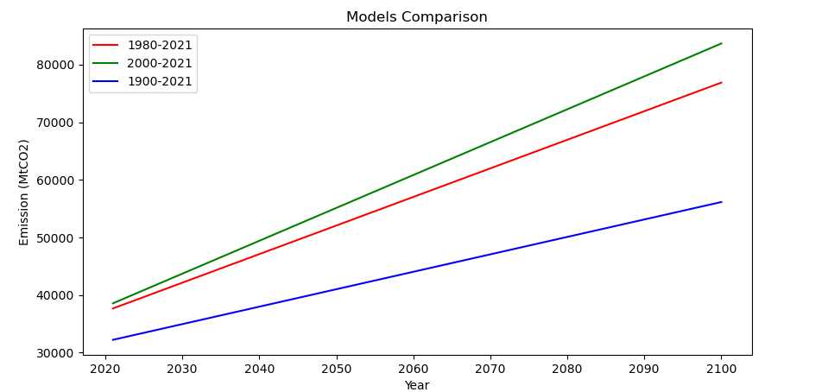
Model Comparison (Removing Exponential Outlier)
Since 1900 the emission growth rate has drastically increased. The predicted emission shifted upward over the years.
The graphs shows that the emission level does seems to want to plateau in term of growth rate.
All graphs shows that the CO2 level will keep increasing with the current global emission rate. This is true for all 3 predictions.
Hence, we will not meet the Paris Accord Goal of around ~16000 MtCO2 by 2030 (assuming same trend).

Slide 12
Unsupervised Machine Learning
The dataset provides detailed emissions level by country for over 200 years. This can give us an insight into how each country's emission level changes over the course of history.
By grouping countries together, we can identify large emitting countries quickly and target them to reduce emissions the most. For this task, we utilized unsupervised learning techniques, specifically K-means clustering. We focused on 1970, 2000, 2021.

Slide 13
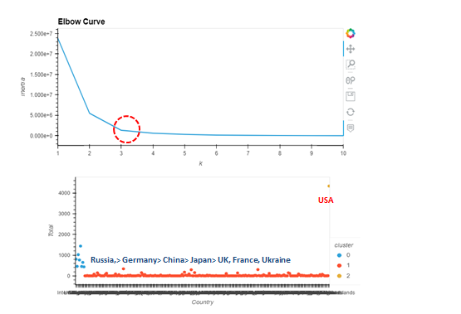
Unsupervised ML 1970

Slide 14
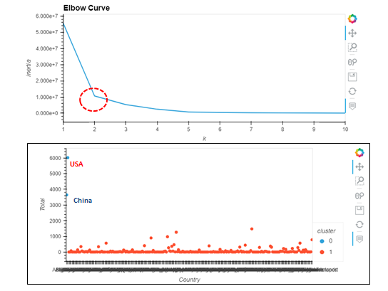
Unsupervised ML 2000

Slide 15
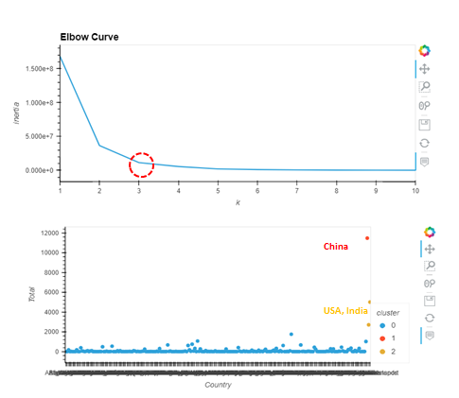
Unsupervised ML 2021

Slide 16
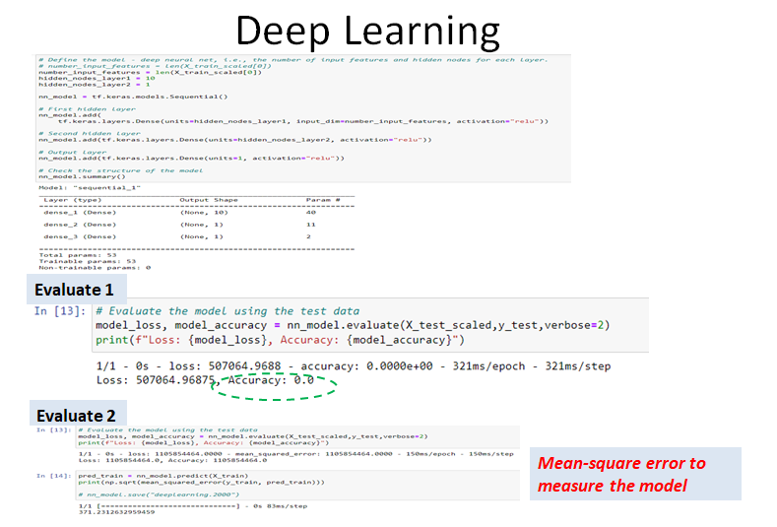
Deep Neural Network
Deep neural networks can learn from large sets of input data, regardless of data complexity. We wanted to explore deep neural networks to see if it's a good use case for our dataset as well.
Not a good fit because it does not work on continuous data

Slide 17
Data Visualization
Country emission by year
Country emission by trend (1750-2021)
Global Prediction

Slide 18
Conclusion
The Paris climate accord goal of CO2 emission by 2030 will not be reached (40% CO2 emission reduction rate compared to the 1990's level). Almost triple the target rate set for 2030 (~16000 MtCO2) based on current assumptions.
China (30.9%), USA (13.5%), India (7.3%) are the world biggest polluters. These 3 countries emitted more than 51.7% (19189 MtCO2) of all global CO2 in 2021.
Trend of how emitting countries change throughout history. Largest emitter in 1970 were the USA, as well as in 2000, and eventually they were surpassed by China in 2021, with India close behind.

